Slide 2
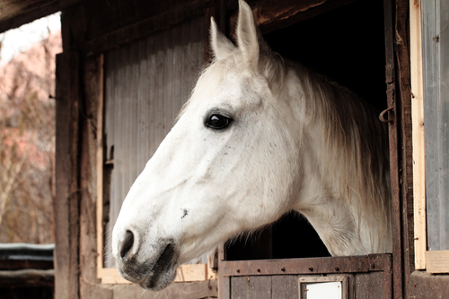
Housing
Provides for welfare
Keeps the horse safe and healthy; as well as the horse’s handlers
Is cost-effective
2

Slide 3
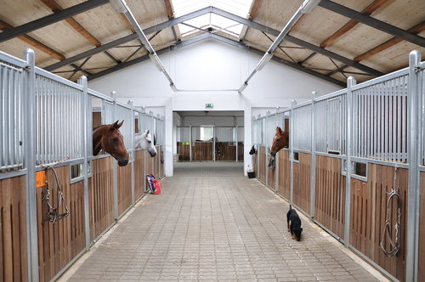
Getting Started
Make sure to select a site with the following
approved for housing livestock animals
adequate drainage for water and manure
easily accessible facilities and utilities
select a site which can be easily reached from a driveway or road
barn needs to be close to exercise areas
water and electricity are essential
3

Slide 4
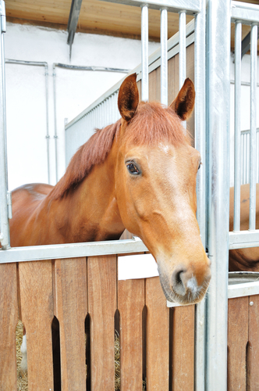
Zoning
Determine if building codes, construction restrictions or health regulations will prohibit or restrict construction
Regulations exist to protect the quality of life and health of neighbors
Check with local health board for regulations
Check for deed restrictions, easements or rights-of-way upon the property
Always consult with neighbors before building
4

Slide 5
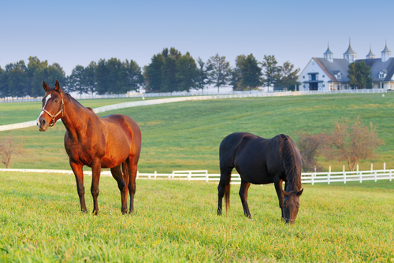
Drainage
Single most important factor in selecting a location
Needs to provide good drainage away from the building
Ideally, land should slope in all directions
Avoid drainage toward neighbor’s property
5

Slide 6
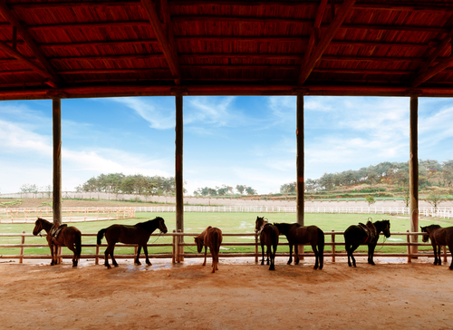
Considerations
Purpose of housing
How many and what breed of horses will be housed
Regulatory requirements
Budget
Layout
6

Slide 7
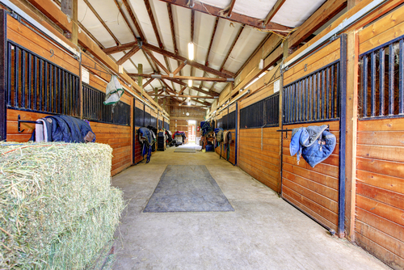
Positions & Floors
Position stables away from dust sources
Avoid steep slopes to prevent slipping and injuries
Make flooring absorbent, easy to clean and resistant to pawning and slipping
Remove top soil before building stall floors
7

Slide 8
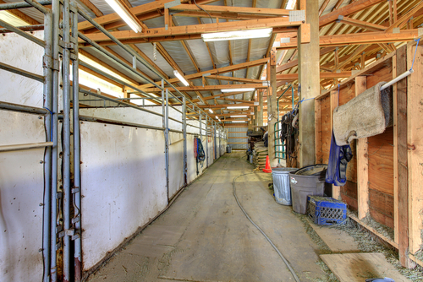
Types of Stall Floors
Concrete/asphalt
Clay/sand mixture
Limestone/dust
Rubber floor mats
Clay
Wooden floors
Sand
8

Slide 9
Door Design
Small doorways increase the risk of injury
Sliding doors are very useful
Half-open hinged doors tend to block or decrease the available width of passage
Door should be at least 4’ wide and solidly built
Door latch should be operable from both inside and outside the stall
Door latch should be simple to use, but not simple enough for a smart horse
9

Slide 10
Stall Design
Should be built of durable, solid materials which will withstand rubbing and kicking of horses
Wood is the most widely used
At least 2” thick wood planking needed
Treated wood recommended for bottom planking
Wood is cheap, but a fire hazard
Walls should be smooth with no protrusions
Can also be made of concrete block or brick
Block and brick is warmer and not a fire hazard
Steel and aluminum can also be used
10

Slide 11
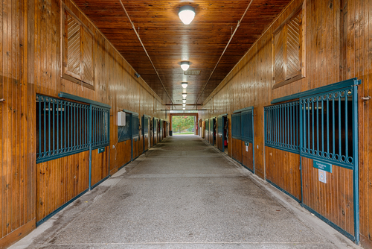
Stall Size
Depends on the breed of horse and how active the horse is
Ceiling should be no less than 8’
11

Slide 12
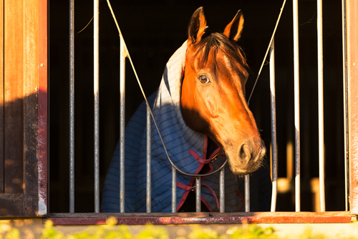
Ventilation
Reduces problems with odor, bacteria and wetness
Circulates air in to keep animals cool in hot summer months
Properly placed and adequately sized vents and roof ducting are essential for ventilation
12

Slide 13
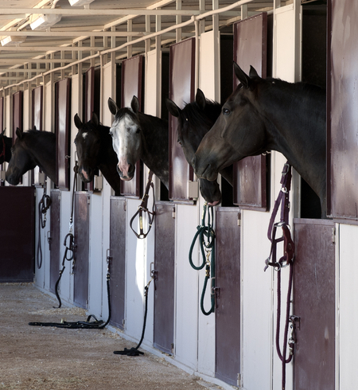
Stall Warmth
Horses can tolerate a wide range of temperatures
Newborn foals or young stock can be stressed by cold and an extra source of heat may be necessary
Supplemental heating is often used to prevent freezing of water pipes
Drafts should be avoided during extremely cold weather
13

Slide 14
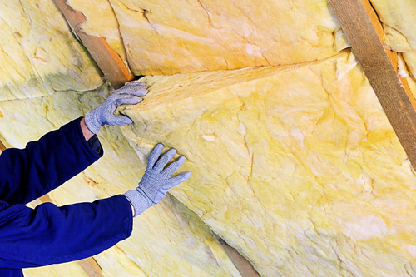
Insulation
Insulation only keeps stables a few degrees warmer than outside temperature
Insulation decreases the risk of condensation
14

Slide 15
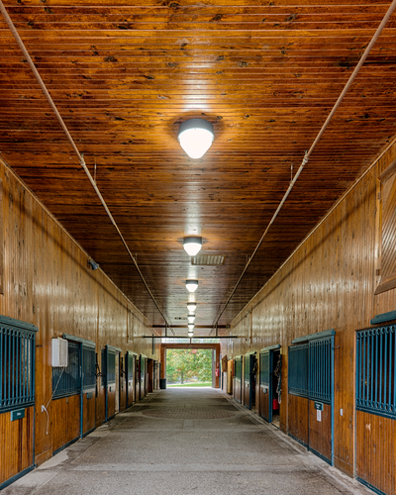
Lighting Needs
Dark boxes often lead to behavioral problems
Sunlight has ultra-violet light, a natural killer of airborne bacteria and viruses
Approximately 10 percent of skylight in roof is suitable
Light is the main factor in the shedding of hair
Light also stimulates the glands and the production of hormones in the estrous cycle
15

Slide 16
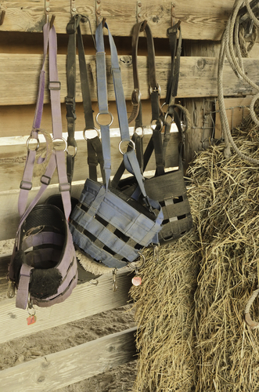
Storage Facilities
Dust and water in feed areas can lead to forage mites which
damage feed
cause skin problems
cause upset stomachs
Fans or air filters are essential
Storage facilities should be vermin proof and clean
16

Slide 17
Water
Must be adequate and easily accessible to horse
Via a frost-free hydrant, hose or bucket are least costly methods
Must be kept from freezing in cold weather
Bucket should be emptied, cleaned and refilled daily with fresh water
Via automatic waterers
saves labor, but is very expensive
should be checked daily and cleaned with disinfectant regularly
17

Slide 18
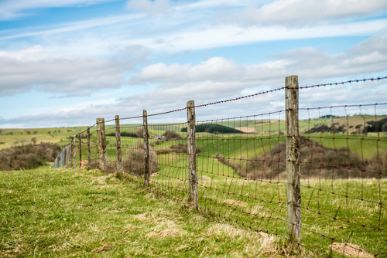
Fencing
Keeps out unwanted animals
Needs to be properly constructed and maintained
18

Slide 19
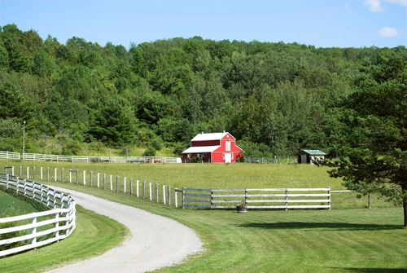
Fencing Considerations
Safety
Efficiency
Cost
Aesthetics
Height
19

Slide 20
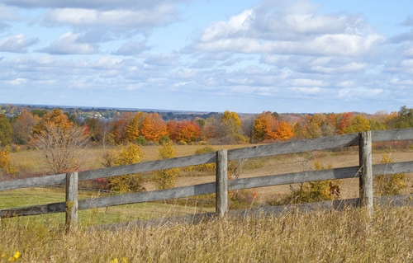
Fencing Materials
Wood
traditional
sturdy
expensive, but practical
requires maintenance
posts need to be at least 4” squares in diameter
20

Slide 21
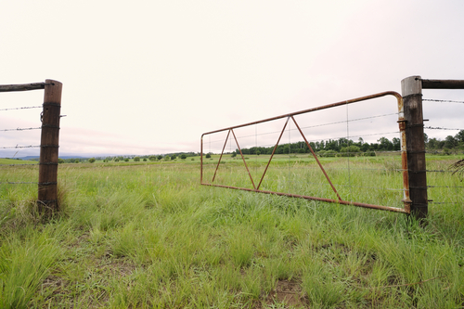
Fencing Materials
Synthetic post and rail fencing
expensive to install and maintain
does not require paint
21

Slide 22
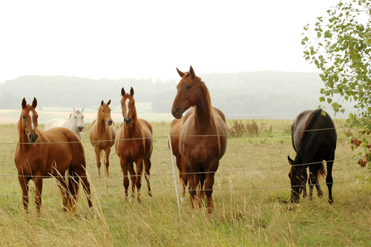
Fencing Materials
Wire fencing
with a close weave prevents feet from being caught
is strong and somewhat flexible
Electric fencing
attached as a single wire on top of a wooden or wire fence
is not very visible
22

Slide 23
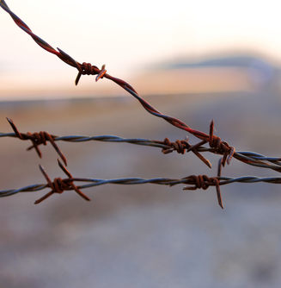
Fencing Materials
Barbed wire fencing
is not recommended for horses
is likely to cause young horses to injure themselves
PVC posts and rails
are low maintenance
are cost effective
are strong and flexible
23

